Slide 1
Look! It’s A Ryan (Orion)
Alex W, Ryan Z, Tony X

Slide 2
Agenda
Introduction
The CNN
Product demonstration
Applications of Machine Learning in Astronomy
GAN
Future possibilities

Slide 3

2
1

Slide 4

CNN (Cable News Network Convolutional Neural Network)

Slide 5

Overfitting
15 x 4 = 60
3 x 8 = 24
12 x 8 = 60
5 x 11 = 24
I know this is the right answer. I am so good at math!
Oh no!

Slide 6
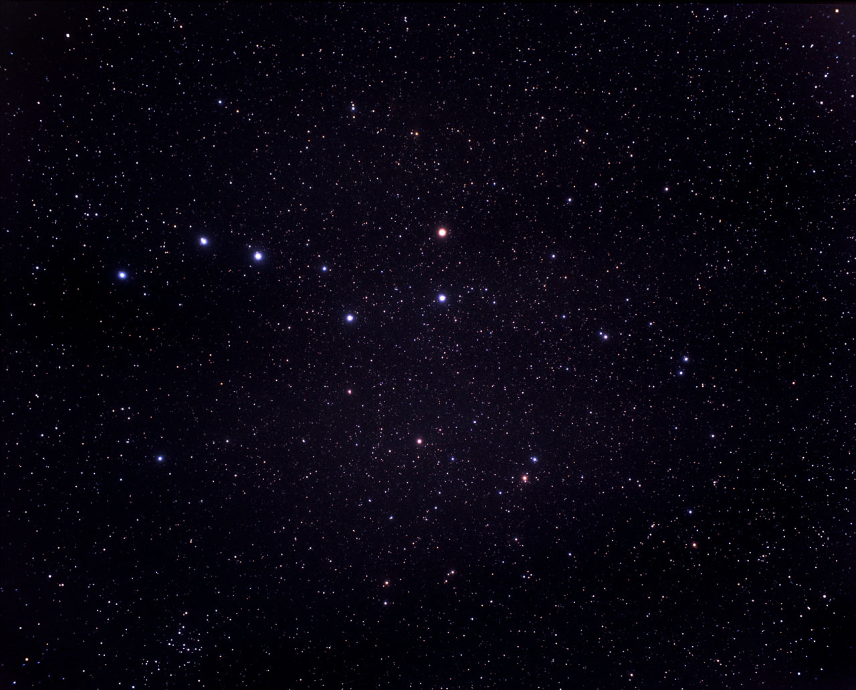

Orion?

Slide 7
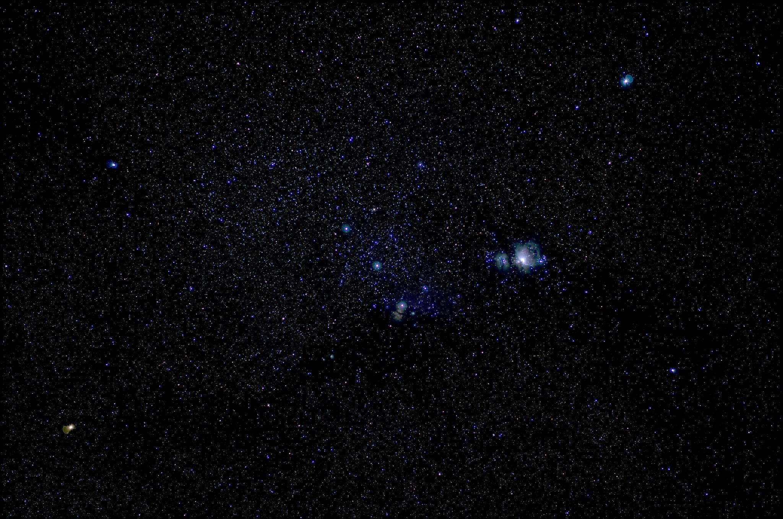
Orion!

Slide 8
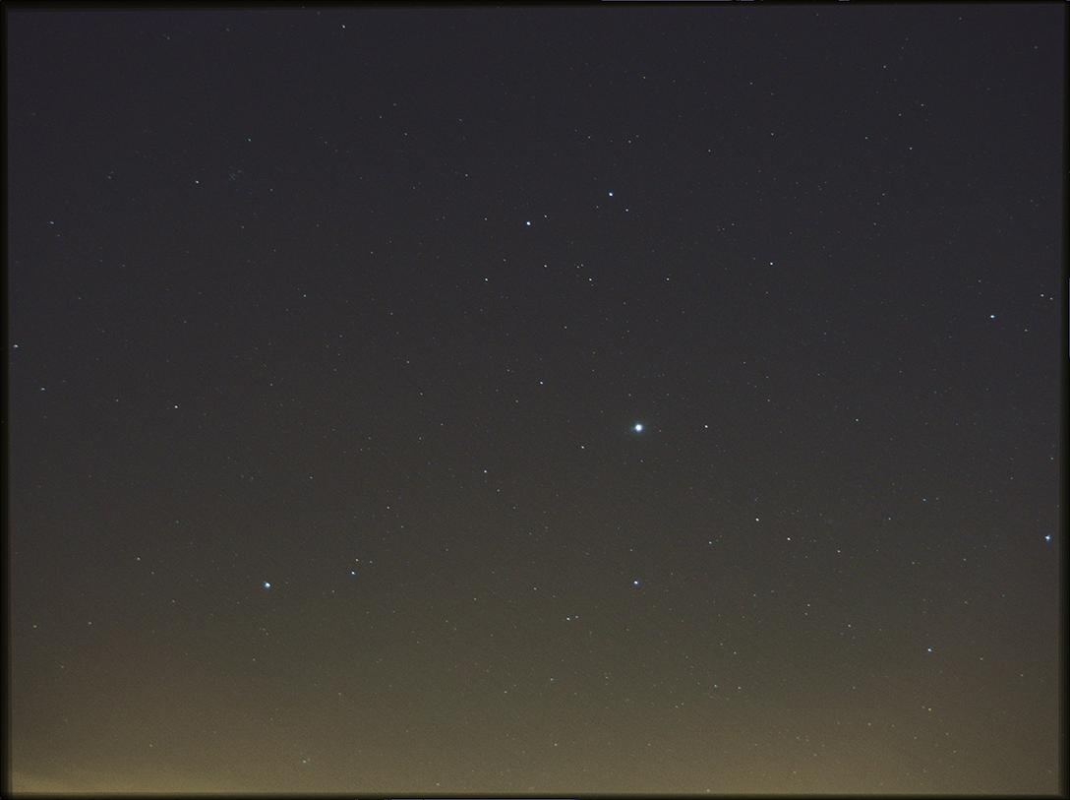
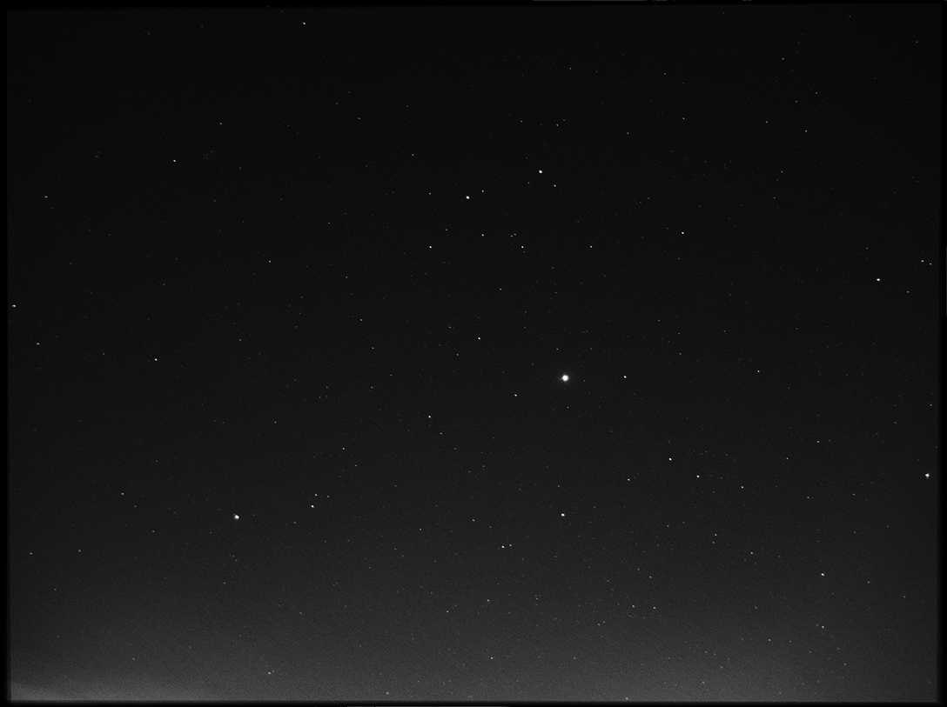
Live Demonstration

Slide 9


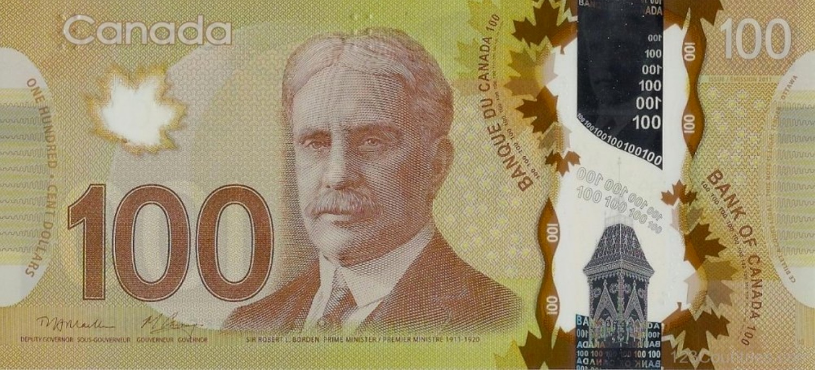
Generative Adversarial Network (GAN)
Dude, that’s not even yellow!
Dude, where’s our beloved Sir Borden?
Good job dude, I can’t tell which one is fake. You are still arrested though.
$100
$100
$100
$100

Slide 10
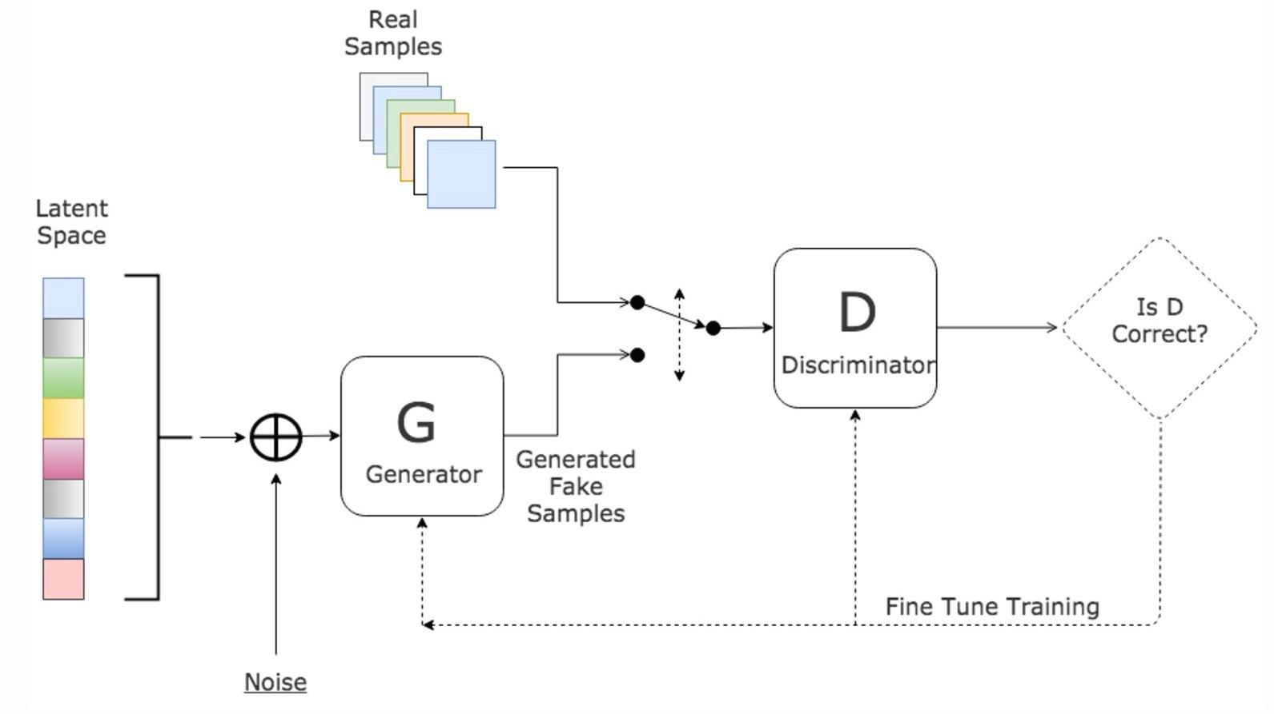
Generative Adversarial Network (GAN)

Slide 11
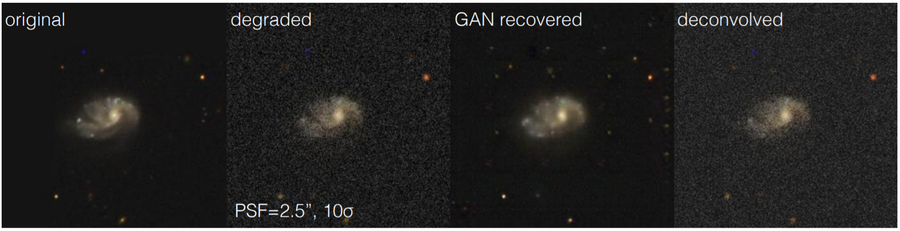

Slide 12
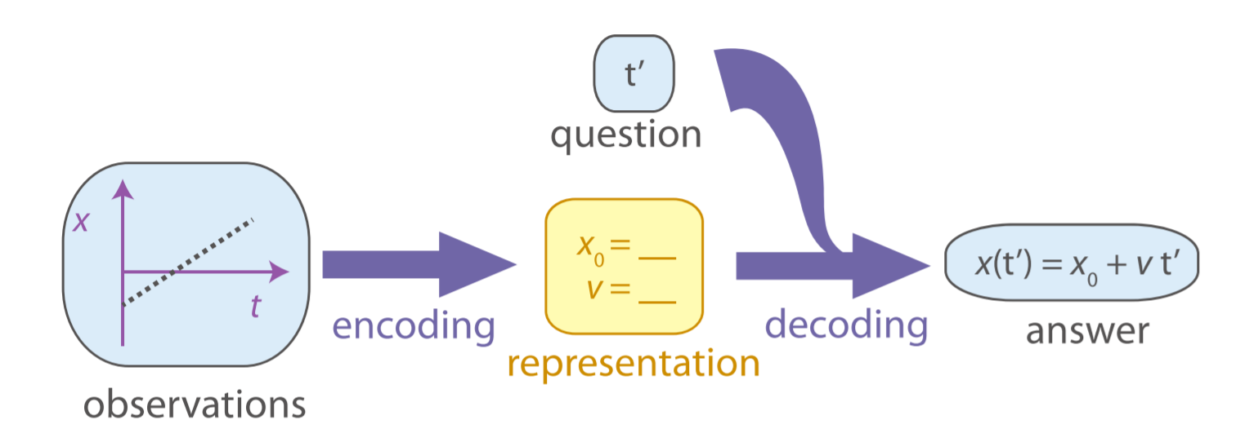
Future Possibilities
How scientists derive scientific laws

Slide 13
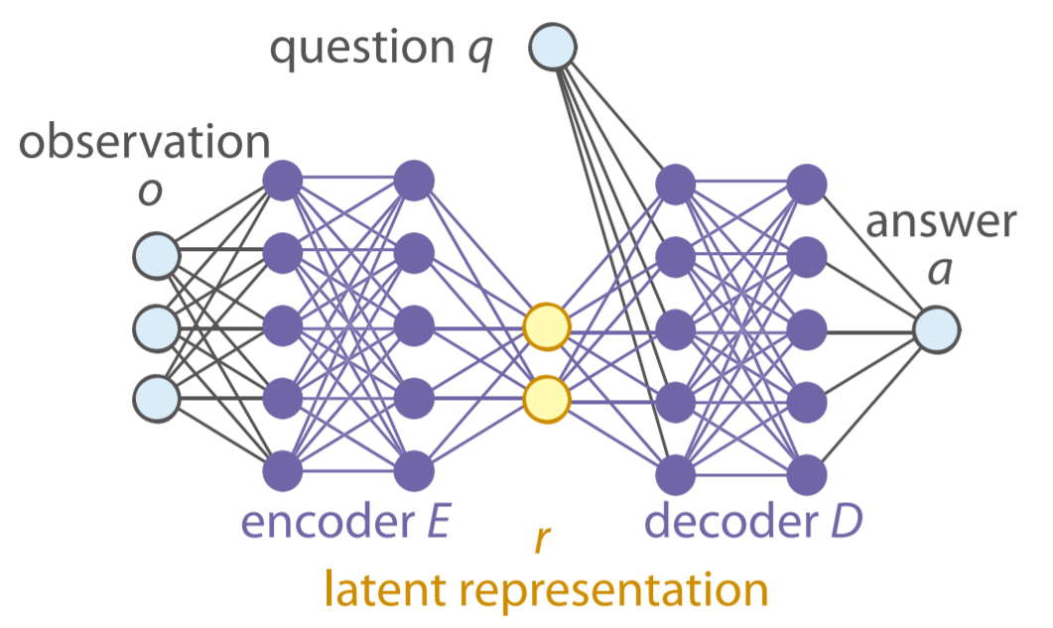
Future Possibilities
How a feed forward network imitates the process

Slide 14
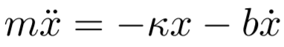
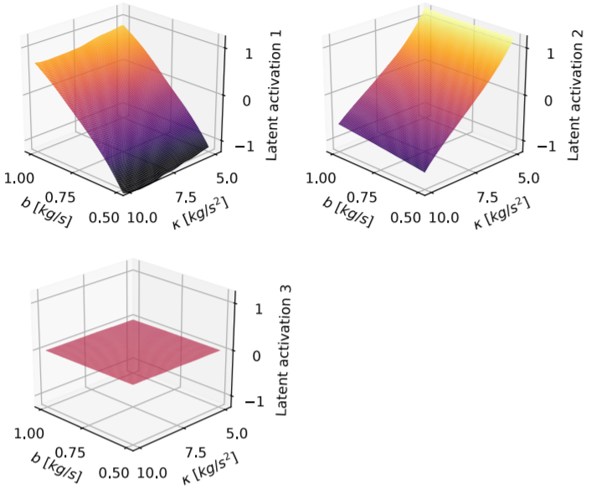
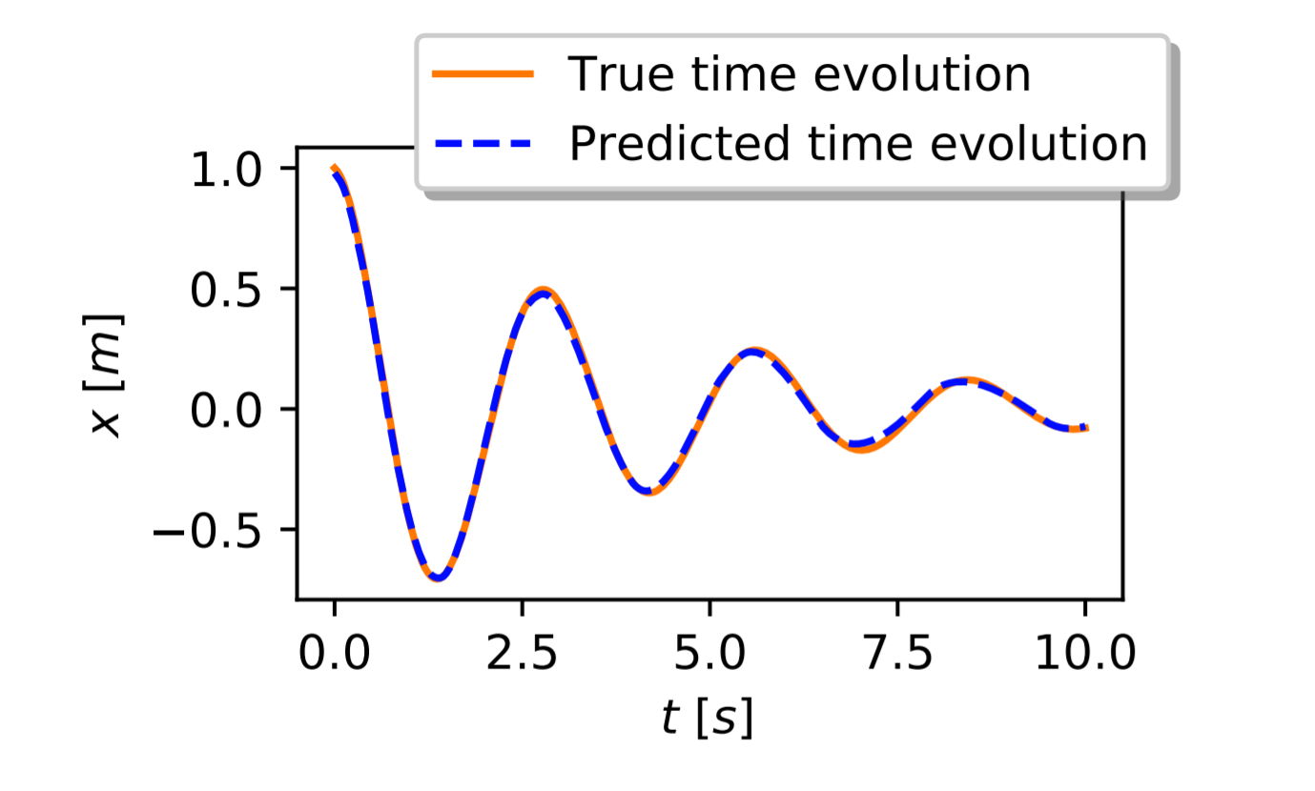
Future Possibilities
Known relationship of damped pendulum motion:

Slide 15
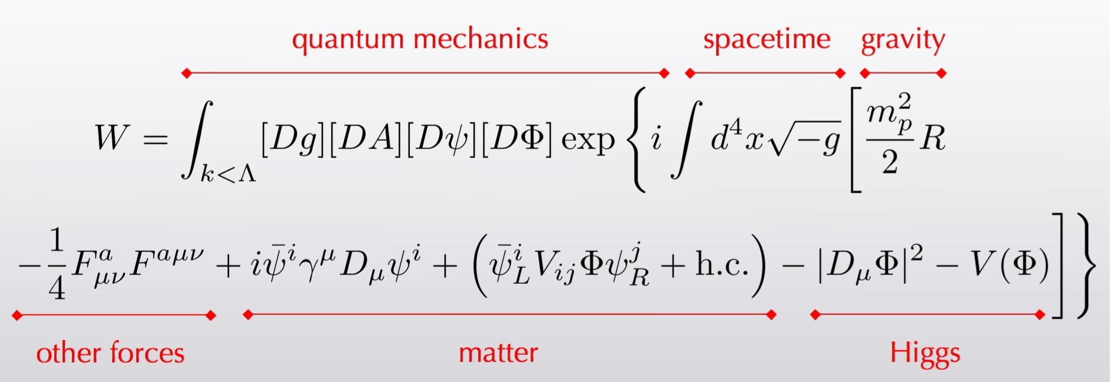
Future Possibilities
Is this the most simplified representation?

Slide 16
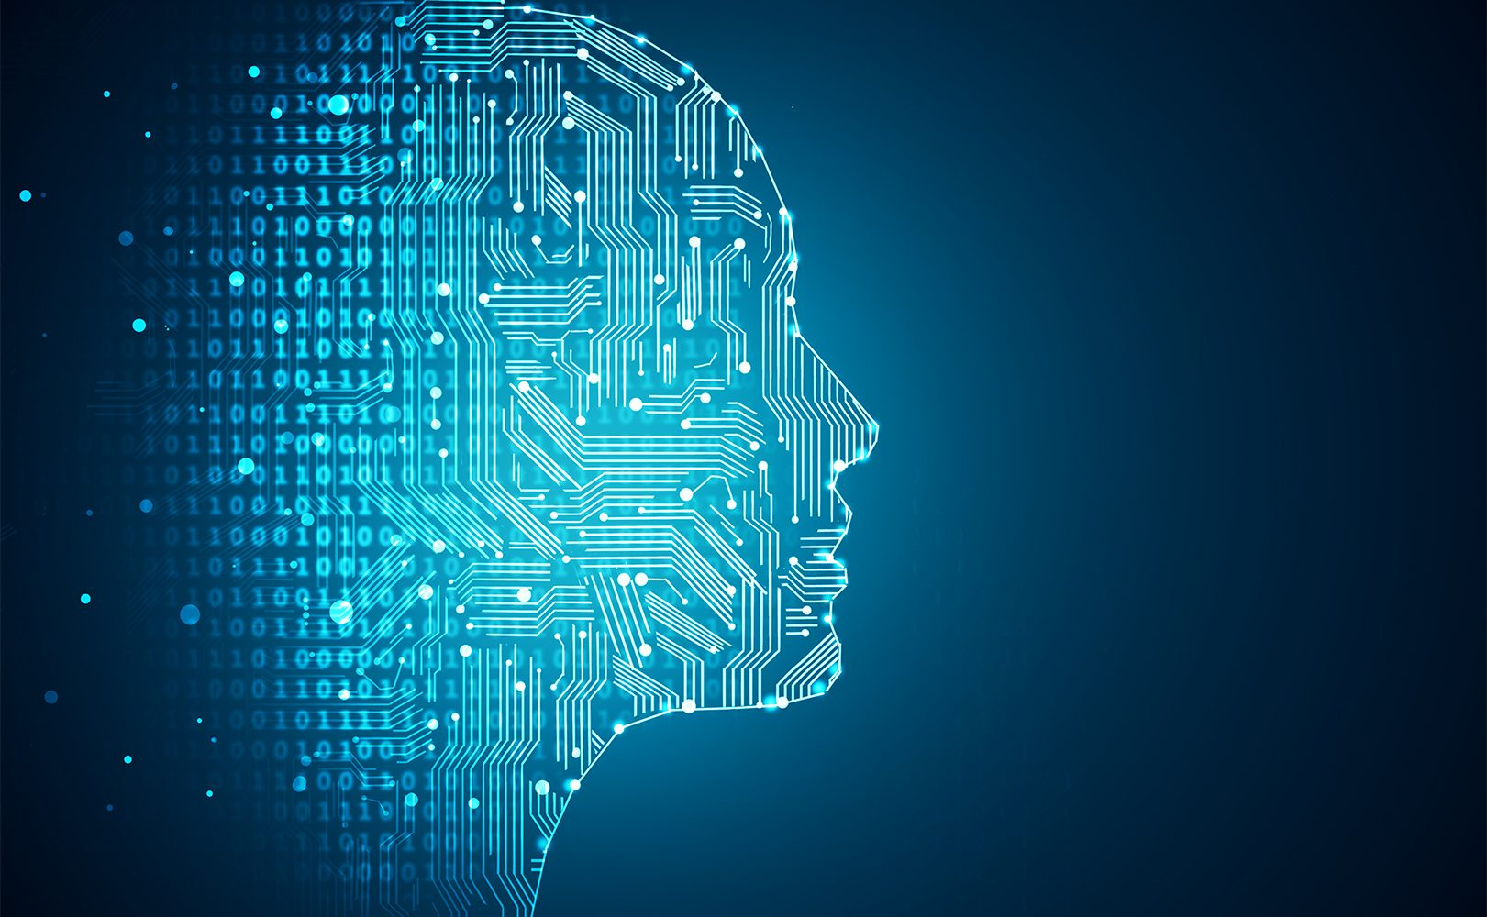
Notes:
The importance of neural network is increasing from day to day as more and more data flow in. It helps astronomers in various aspects, as it allows astronomers to classify images at a much faster speed and analyze images with a higher quality. Artificial intelligence is also reinventing science, as it provides people another way of developing scientific theories. Before long, machine learning will become an essential skill astronomers should know.

